Slide 1
Data Interoperability
2024
Ms. Katherine Escobar
Joint Staff J6
NIEMOpen
Notes:
Hello and welcome to an overview of how NIEM, the State Local Tribal and Territorial, and the Cybercrime Support Network will assist you to solve your data interoperability concerns while concurrently implementing the NIEMOpen Cyber Domain.

Slide 2
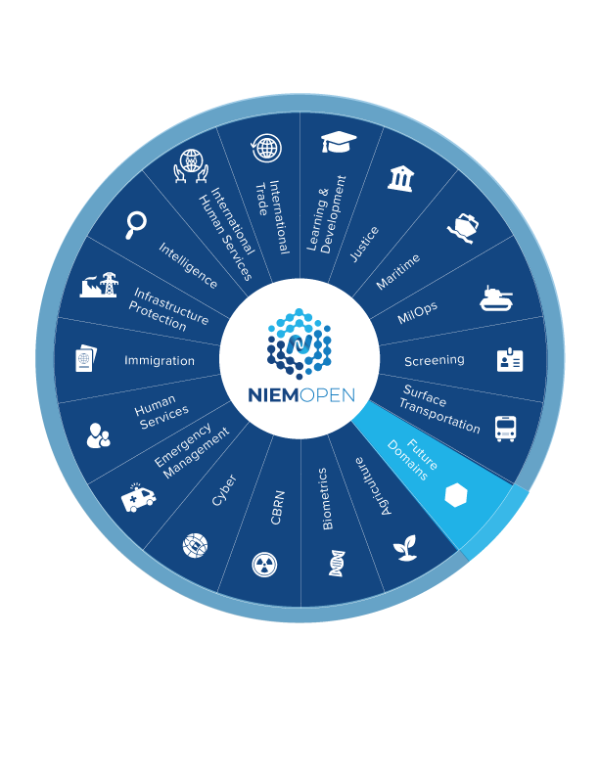
Agenda
DoD Interoperability Challenges
NIEMOpen Open
How to Get Started
Next Steps
Notes:
For the Agenda, we will cover:
A discussion on the Interoperability Challenges plaguing most organizations
An overview The National Information Exchange Model, (NIEM), and how it can help to resolve some of these challenges
The State Local Tribal Territorial NIEMOpen Pilot effort for Cyber Incident Response & Reporting
And Next Steps
So let’s get started

Slide 3
Why NIEMOpen?
Our mission is furthered by the sharing of data:
With Federal, State, Local, Tribal, Territorial, International partners (ex: DHS, FBI, etc.)
With industry and vendor partners
With compliance drivers (ex: PCI for credit card data, HHS for HIPAA data, etc.)
For Interagency, this includes:
Multiple, complex data sharing permutations via forms, digital, emails, phone calls, Slack, and other mechanisms
Data must be shared across multiple networks, multiple security boundaries, multiple IT capabilities, and in multiple ways, but still be understandable
Component programs are not equipped to handle all domains in this Enterprise-level data sharing challenge
Notes:
We have found that SLTTs have one of the most complex data sharing environments that exist in the industry today. You must share data with multiple federal agencies, other SLTTs, ISACs, ISAOs, working groups, industry and vendor partners, and all driven by compliance requirements.
The different agencies and partners adhere to different standards, developed at different times, for different purposes. Legacy systems have to integrate with new systems, and adoption of different cyber taxonomies, like STIX and VERIS that were developed and are focused on a single domain scope, cyber, without forethought for sharing data between agencies or across information domains.
As a consequence, data management and information sharing, is fragmented at best and repetitive reporting is required, resulting in old data, shared slowly, which limits decision making and response actions.

Slide 4
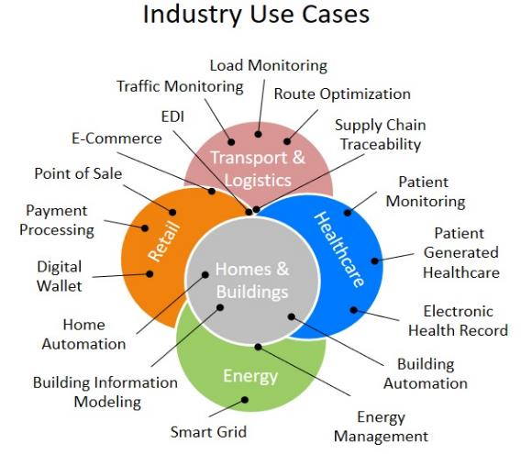
DoD Interoperability
Across all levels of government, industries, and technical solution providers, interoperability is an essential tool for:
Better decision making
Reduction of manual processing
Increased productivity
Reduction of errors
Management of costs
Everyone agrees it takes interoperability of systems
to achieve these benefits.
Notes:
interoperability between disparate systems requires highly structured data exchange procedures (i.e., standards) that ensure that data sent by one system can be interpreted and used by a receiving system
interoperability is necessary for cross-agency data sharing given the wide variety of technical architectures and products being used in public safety communication systems today. Furthermore, real-time cross-agency data sharing will require a greater degree of interoperability
For two applications to exchange mutually intelligible data, the data exchange standards they employ must not only be written in the same language, but they also need to use shared terms and definitions and follow the same relational structure (i.e., they must follow a shared schema)

Slide 5
DoD Interoperability Challenges
If everyone agrees, why is there a lack of interoperability problem?
Lack of unified agreement on standards selection and implementation
Siloed (domain-specific) development efforts driven by need, isolated by incompatibility
Proprietary and vendor-driven solutions vs. Interoperable driven solutions
Information Blocking - business, technical, and organizational practices that prevent or materially discourage access, exchange or use
Notes:
Technical barriers, though challenging, are eclipsed by the policy, legal, business, and sociotechnical barriers to greater interoperability
Historically, there have been a plethora of domain specific connectivity technologies, tightly integrated and optimized to solve domain specific connectivity needs. Proprietary connectivity technologies and specialized connectivity standards optimized for a narrow set of domain-specific use cases in vertically integrated systems. These domain-specific connectivity technologies, though optimal in their respective domains, can be a hindrance to the sharing of data, designs, architectures, and communications essential to creating new value streams and unlocking the benefits of interoperability. Domain-specific connectivity technologies include emerging technologies, optimized for certain use cases.
21st Century Cures Act: Interoperability, Information Blocking, and the ONC Health IT Certification Program defines info blocking as business, technical, and organizational practices that prevent or materially discourage the access, exchange or use of electronic health information (EHI) when an Actor knows, or (for some Actors like EHR vendors) should know, that these practices are likely to interfere with access, exchange, or use of EHI. If conducted by a health care provider, there must also be knowledge that such practice is unreasonable and likely to interfere with, prevent, or materially discourage access, exchange, or use of EHI.

Slide 6
DoD Interoperability Solution
The key factor to achieve interoperability is data
Information exchange is critical to ensuring timely information is available when and where it is needed
To exchange data, systems must have agreement on:
Syntactic: Data encodings and representation
Semantic: Consistent terminology and meanings
NIEMOpen Solves the Interoperability Challenge
at the Data Level
Notes:
The variety of data and wide range of data formats, logical models, timescales, and semantics, make it difficult to employ analytics and complicates interoperability

Slide 7
NIEMOpen for DoD interoperability
NIEMOpen is specifically and uniquely designed to meet the DoD enterprise-level data sharing requirement
White House directed as a result of 9/11 data sharing lessons learned
DOD assumed stewardship from DHS of the NIEMOpen Initiative 31 Oct 2018
Executive lead: DOD CIO
In partnership: DOJ, HHS, DHS
Day-to-day management: JS J6
Resources and requirements sponsor: MPCO
Governance includes 17 Domains
From 12 different Federal government departments, agencies plus Canada
DOD led Domains - Military Operations (JS J6) and Maritime Domain (Navy)
Includes Canada and NATO (as NATO Core Data Framework)
4

Slide 8





DOD Adoption of NIEM
28 March 2013
DoD CIO NIEMOpen Adoption Memo states:
“ … DOD will adopt the National Information Exchange Model (NIEM) as best suited for standards-based data exchanges.” “DOD organizations shall first consider NIEMOpen for their information sharing solutions…”
DoDI 8320.07:
“ … the use of NIEM-based exchanges must be considered for all new Extensible Markup Language (XML) information exchanges created and for all XML information exchanges being modernized as part of the normal lifecycle management for these information exchanges.”
August 2015
January 2017
DepSecDef Memo Improvements to DoD Unclass Shared Situational Awareness:
“ … Commander, NORTHCOM and PACOM will use NIEMOpen in accordance DoDI 8320.07 leveraging existing DoD capabilities, to provide DoD mission partners with a clear and concise DoD central authoritative data source for the sharing of unclassified information related to disasters….”
December 2018
CNO Message R 261805Z DEC 18 Transforming Our End-to-End Information Environment – Compile To Combat In 24 Hours Implementation Framework:
References the DoD CIO Memo and directs “… Adoption of the National Information Exchange Model (NIEM) with the DoD, and establishing that model as the DoD mandated data sharing model..”
Notes:
“NIEMOpen First” policy codified in DOD CIO issuance 8320.07
The key driver in DoD adoption is “Consider NIEMOpen First”
The “NIEMOpen First” rule tells the program developers to either:
Provide a NIEM-based interface for every new exchange, or
Obtain an exception for their preferred alternative approach
Exceptions are granted by the DoD CIO
Justified by the business case for the alternative
Through a process that is simple and easy as it can be
You don’t have to retire existing non-NIEMOpen exchanges
You don’t have to replace an existing data exchange just to make it conform to NIEM
Even if you are modernizing the implementing system
So long as the exchange specification doesn’t change
You can use any standard you like for a new exchange
Either by obtaining an exception
Or by providing a NIEMOpen interface along with your favorite

Slide 9
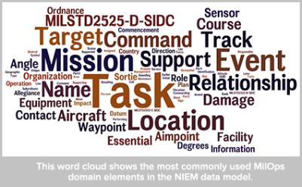
MilOps DOMAIN Scope
The NIEMOpen MilOps domain manages those unique military operations and missions data components in NIEM
Components support mission critical information sharing requirements within DOD, and/or with other Federal government agencies, and Mission Partners.
MilOps Domain is a catalogue of data components, modeled in XML schema, and will be used to support information exchange requirements from the following DOD functional categories:
Force Support
Battle Space Awareness
Force Application
Logistics
Cyber and C4
Protection
Notes:
The NIEMOpen MilOps domain manages those unique military operations and missions data components in NIEM
Components support mission critical information sharing requirements within DOD, and/or with other Federal government agencies, and Mission Partners.
MilOps Domain is a catalogue of data components, modeled in XML schema, and will be used to support information exchange requirements from the following DOD
functional categories:
Force Support: maintenance and management of a mission ready force
Battle Space Awareness: dispositions and intentions as well as the characteristics and conditions of the operational environment that bear on national and military decision-making
Force Application: maneuver and engagement in all environments to create the effects necessary to achieve mission objectives
Logistics: support needed for the projection and sustainment a logistically ready force
Cyber, Command, Control, Communications, and Computers: authority and direction over forces and resources
Protection: prevention / mitigation of adverse effects of attacks on personnel and physical assets

Slide 10
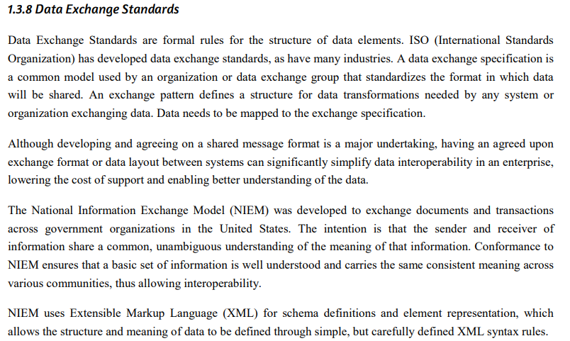

Data Management Book of Knowledge (DMBOK)

Slide 11
What Is Interoperability
Interoperability is a characteristic of a product or system, whose interfaces are completely understood, to work with other products or systems, present or future, in either implementation or access, without any restrictions.
Semantic interoperability is the ability of computer systems to exchange data with unambiguous, shared meaning. Semantic interoperability is a requirement to enable machine computable logic, inferencing, knowledge discovery, and data federation between information systems.
Syntactic interoperability refers to the packaging and transmission mechanisms for data. Syntactic interoperability is a prerequisite for semantic interoperability. Enabled by metadata
Metadata is data that defines and describes other data
Notes:
What is interoperability? Interoperability, within the context of European public service delivery, is the ability of disparate and diverse organisations to interact towards mutually beneficial and agreed common goals, involving the sharing of information and knowledge between the organisations, through the business processes they support, by means of the exchange of data between their respective ICT systems. Source: EIF, http://ec.europa.eu/isa/documents/isa_annex_ii_eif_en.pdf
Ref: "Definition of Interoperability". dedicated website for a Definition of Interoperability at interoperability-definition.info. Copyright AFUL under CC BY-SA.
Ref: NCOIC, "SCOPE", Network Centric Operations Industry Consortium, 2008
Ref: ISO/IEC 11179-1 Information technology – Metadata registries (MDR) part 1: Framework

Slide 12

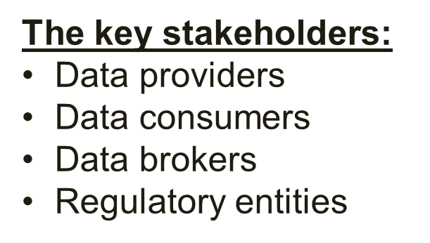

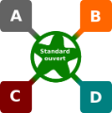
Degrees of Interoperability
Current
Compatibility - Compatibility is the ability for two systems of different types to communicate with each other
De Facto: When an actor becomes dominant in a domain, the other actors make sure to be compatible with him. Advantage: all systems can more or less communicate with each other. Disadvantage: the dominant actor somehow controls this possibility, competition for dominance exists.
Interoperability: Interoperability is the possibility for different systems to communicate with each other without depending on a particular actor. It is based on the presence of an open standard
Future
Effective information sharing is critical to our JADC2 mission
Notes:
Ref: "Definition of Interoperability". dedicated website for a Definition of Interoperability at interoperability-definition.info. Copyright AFUL under CC BY-SA.

Slide 13
Interoperability Challenges
If everyone agrees Interoperability is necessary, why is there an interoperability problem?
Lack of unified agreement on standards selection and implementation
Uncompromising mindsets focused on one size fits all solutions
Siloed (domain-specific) development efforts driven by need, isolated by incompatibility
Proprietary and vendor-driven solutions vs. Interoperable driven solutions
Information Blocking - business, technical, and organizational practices that prevent or materially discourage access, exchange or use
Single model -- one size fits all answer -- infeasible
Think Big Enterprise vs. mission focused/stovepiped enterprise
Notes:
Without semantic interoperability, Interoperability conflicts arise Semantic conflicts can occur at two different levels, at the data level and at the schema level. Conflicts on a data level occur due to data differences in different domains. Conflicts on schema level are semantic conflicts characterized by differences in logical structures Data-level conflicts • Different representation and interpretation of similar data Schema-level conflicts • Different logical structure or inconsistencies in metadata 13 More on semantic conflicts: Peristeras - JIS-2008-34-6-877 - A conceptual analysis of semantic conflicts in pan-European e-government services Schema isomorphism conflict i.e. Different attributes on ID cards in different states How do you interpret this data?
Ref: "Definition of Interoperability". dedicated website for a Definition of Interoperability at interoperability-definition.info. Copyright AFUL under CC BY-SA.

Slide 14
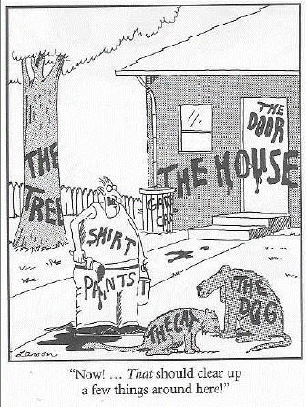
What Semantic interoperability can do for you
Integrate data across disparate data sets and sources and federate data to multiple consumers
Prepare your data to become machine-readable
Uncover patterns and relationships within data
Breakthrough data silos and resolve data discrepancies faster
Provide an entire view of an enterprise’s information landscape (data federation)
Improve database queries in both efficiency and quality
Enhance data discoverability.
Notes:
Without semantic interoperability, Interoperability conflicts arise Semantic conflicts can occur at two different levels, at the data level and at the schema level. Conflicts on a data level occur due to data differences in different domains. Conflicts on schema level are semantic conflicts characterized by differences in logical structures Data-level conflicts • Different representation and interpretation of similar data Schema-level conflicts • Different logical structure or inconsistencies in metadata 13 More on semantic conflicts: Peristeras - JIS-2008-34-6-877 - A conceptual analysis of semantic conflicts in pan-European e-government services Schema isomorphism conflict i.e. Different attributes on ID cards in different states How do you interpret this data?

Slide 15
What is NIEMOpen
Notes:
The National Information Exchange Model (NIEM) is a U.S. government-sponsored initiative to facilitate information sharing among public, private and commercial sector organizations.
Established formally in 2005, NIEM’s initial focus was on law enforcement, public safety, and emergency management, but it is continuously being expanded into other content focused domains.
New initiatives within the U.S. Government, State, Local, Tribal and Territorial Governments, use NIEMOpen as a common base data model and methodology to promote interoperability of data and software, reduce design and development time for information exchange applications, and allow the reuse of intellectual capital and skills across multiple projects.

Slide 16
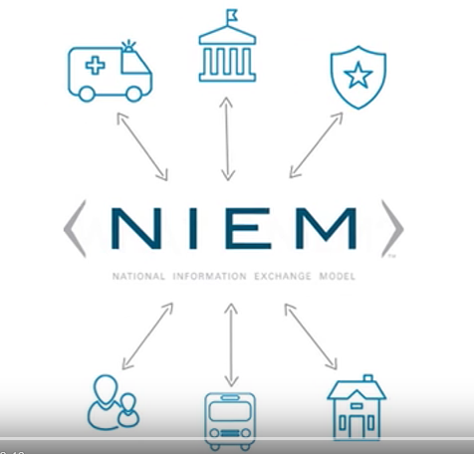
NIEM Simplified
Please click play to begin
https://www.youtube.com/watch?v=BA1jY8LJ8tM
Notes:
Let’s watch a short clip that provides a simplified explanation of NIEM.

Slide 17

NIEMOpen Framework
NIEMOpen formerly National Information Exchange Model, is a community-driven, government and jurisdiction-wide, standards-based approach to exchanging information
Diverse communities can collectively leverage NIEMOpen to increase efficiencies and improve decision-making
NIEMOpen is available to everyone, including public and private organizations
NIEMOpen includes a data model, governance, training, tools, technical support services, and an active community to assist users in adopting a standards-based approach to exchanging data
NIEMOpen Community
Technical Framework
Support Framework
Formal Governance Processes
Data Model
Tools for Development and Discovery
Online Repositories
Design Rules
Established Training Program
Mission-Oriented Domains
Development Methodology
Implementation Support
Predefined Deliverables
Message Exchanges
(a.k.a IEPD)
Self-Managing Domain Stewards
Help Desk & Knowledge Center
Notes:
NIEMOpen is a community-driven, government-wide, standards-based approach to exchanging information. Diverse communities can collectively leverage NIEMOpen to increase efficiencies and improve decision making.
There are three different aspects to the value of NIEM: community interaction, a technical framework that helps define data structures, and a support framework that helps from an implementation perspective.
The Cybersecurity and Infrastructure Security Agency (CISA) is using NIEMOpen and NIEM’s Cyber Domain to ensure efficient and accurate NIEMOpen data exchanges regarding cyber incidents among public and private agencies. As part of that operation, CISA is working with the non-profit Cybercrime Support Network to ensure NIEMOpen Cyber domain development fits with the needs of the State, Local, Tribal, and Territorial (SLTT) government community.
NIEMOpen is described as a framework, because it is not just a Reference Architecture that provides a common data vocabulary for information exchanges, it includes several components to enable your implementation and achieve interoperability:
A common data model called NIEMOpen core that provides data components for describing universal objects such as people, locations, activities, and organizations
More specialized business focused data models for more specialized use cases, called domains (examples including Cyber, Justice, Immigration, and Emergency Management)
A methodology for using and extending the building blocks that come from the common and domain-specific models to turn them into a complete information exchanges, known as an information exchange package
Free Tools to help develop, validate, document, and share the information exchange packages
A governance organization that provides training and support and oversees NIEM's evolution over time
NIEMOpen is available to everyone. The NIEMOpen community spans federal, state, local, tribal, international, and private sector entities. It is this diverse group of people who drive NIEMOpen forward. NIEMOpen was built by the community for the community.

Slide 18





Data Interoperability Problem
SPAM ≠
Honeypot ≠
Worm ≠
Cyber Terms
SPAM
Honeypot
Worm
DATA
UNDERSTANDING
(Semantics, Syntax, Structure)
DATA
UNDERSTANDING (Semantics, Syntax, Structure)
IF THESE AREN’T COMPATIBLE…
THIS WON’T WORK
DATA
EXCHANGE @ RUNTIME
SYSTEM / APPLICATION
SYSTEM / APPLICATION
Data Producers
Data Consumers
Notes:
As mentioned earlier, the foundation for all information sharing is data.
Ensuring all partners of an exchange can understand each other is critical to mission success.
In this picture, the data interoperability challenge is to ensure that the different systems have a compatible understanding of the data to be exchanged – because if the systems on the left have a different understanding than the systems on the right, then something will be broken and someone will be unhappy.
Although the graphical comparisons are laughable to a human; computers cannot discern the meaning of one string (e.g., worm vs. worm) from the other unless humans program them to. A computer program designed to recognize a standalone malware worm is not likely to understand a worm insect.
They are spelled the same but have different context.
This is the idea behind NIEM—letting your system and my system speak—even if they've never spoken before. NIEMOpen ensures that information is well-understood and carries the same consistent meaning across various communities, allowing interoperability to occur.”
For machine-to-machine data interoperability, there are software developers who build applications on behalf of producers and consumers. They work from an message exchange package, a build-time description of the data to be exchanged at runtime. If they do their jobs right, then the data produced at one side will be properly interpreted at the other, and everyone will be happy.

Slide 19
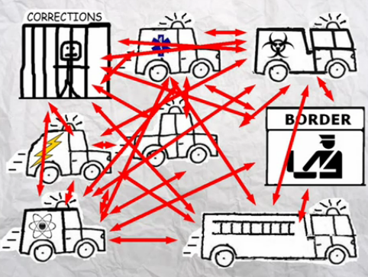
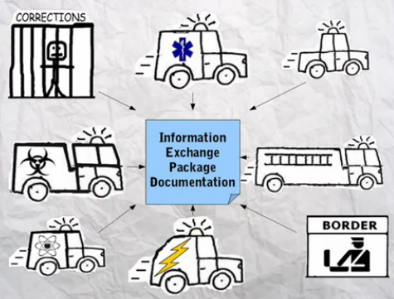
NIEMOpen ADVANTAGE
When using NIEM, you only need to “speak” two languages — your own and NIEM
EXAMPLE Communicating With 15 Different Systems N⁽²⁾ Problem
Without NIEM | Using NIEM

Slide 20
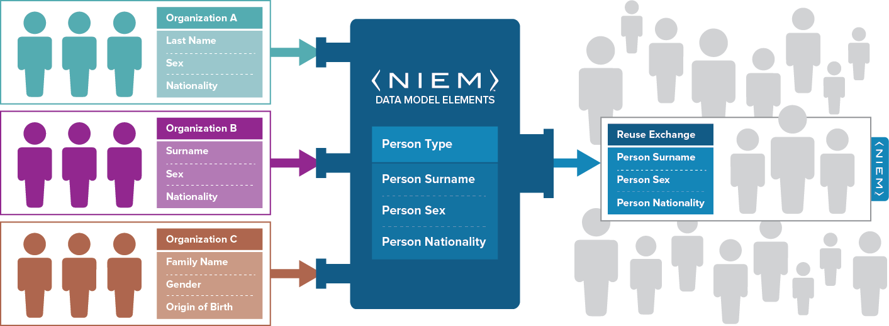

NIEMOpen in action: How NIEMOpen Exchanges Data Components and Data Elements
NIEMOpen is
a common vocabulary –
enabling efficient information exchange across diverse public and private organizations
NIEMOpen is not a system or database – NIEMOpen does not specify how to transmit or store data
Using NIEMOpen, organizations come together to agree on a common vocabulary When additional organizations are added to the information exchange, the initial NIEMOpen exchange can be reused, saving time and money
Notes:
Let’s take a look at a benefit of NIEM: Common Language.
When developing information exchanges, agreeing to a common set of data elements and definitions is a frequent challenge. NIEMOpen was built to address this challenge.
When using NIEM, you only need to “speak” two languages—your own and NIEM. In the example on the slide, three partner organizations need to share information about a person. As you can see, each organization uses a different label for the describing the same type of information, ultimately requiring each organization to build multiple definition mappings and exchanges. As one of the three partner organizations, you would have had to connect to three different systems and negotiate a common language between each of them. NIEMOpen provides this common vocabulary so going forward, it’s just your language and
Cyber example:
Incident = event = breach = compromise
These aren’t exactly the same but we often use them as such
IP address = IPv4 = Internet Protocol Address = IP
4 ways to say the same thing
NIEM, saving time and money.

Slide 21
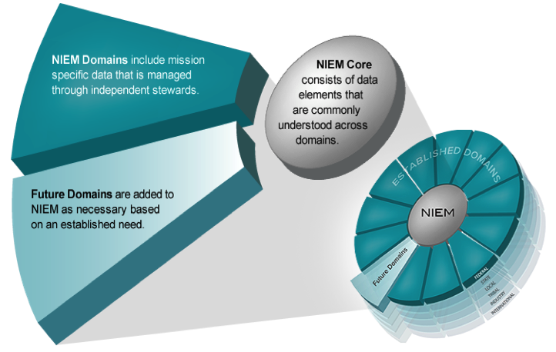

NIEMOpen Model Content
Think of the NIEMOpen data model as a mature and stable data dictionary of agreed-upon terms, definitions, and formats independent of how information is stored inside individual IT systems.
NIEMOpen 17 Domains
Agriculture
Biometrics
Chemical, Biological, Radiological, & Nuclear
Cyber
Emergency Management
Human Services
Immigration
Infrastructure Protection
Intelligence
International Trade
International Human Services
Learning & Development
Justice
Maritime
Military Operations
Screening
Surface Transportation
Notes:
Let’s take a look at a basic example of the NIEMOpen core and the NIEMOpen domain relationship.
All domains would agree that a person has a name and date of birth—commonly agreed-upon characteristics of a person.
Some communities have a business need to extend the definition of a person based on their information exchange requirements. For example, within the Justice community, they need the flexibility to extend Person to capture additional information of a Subject, who may be involved or suspected of being involved in an incident or criminal activity. In addition, a name and date of birth are not sufficient to identify a Subject. They also may require biometric identifiers such as fingerprints, scars, or tattoos to verify their identity.
Another commonly used core element is Activity. For example, the Cyber Domain may need to extend Incident such as a breach event to include additional identifiers such as IP Address or Type to create context.

Slide 22
Standards that include NIEM
ANSI APCO Alarm Monitoring Company to Public Safety Answering Point (PSAP)
OASIS LegalXML Electronic Court Filing Technical Committee
OASIS EXDL, Emergency Data Exchange Language FEMA (Emergency Management Domain)
Nation Fire Protection NFPA 950 calls for compliance with NIEM. Emergency Incident Data Document (EIDD) – NISTIR 8255
Model Minimum Uniform Crash Criteria Guideline (MMUCC) – Department of Transportation
ANSI 42.42 Radiological Nuclear detectors – CBRN Domain
NIST Big Data Framework Vol 7
Biometrics ANSI/NIST ITL Standard – Biometrics Domain
Biometric Conformance Test Software (BioCTS)
BioCTS for AN-ITL v2 is a desktop application which tests electronic biometric data files, known as transactions, for conformance to NIST Special Publication (SP) 500-290
Conformance Test Architecture (CTA) and Test Suite (CTS) called "BioCTS for AN-2011 NIEMOpen XML" designed to test implementations of AN-2011 NIEMOpen XML encoded transactions.
NIEMOpen cited in patent – Integrated Environment for Developing Information Exchanges patent No: US 8,769,480 B1 Dated July 1, 2014
Notes:
Another point to highlight is that you may be using NIEMOpen and not even know it.
NIEMOpen has been incorporated and leveraged by several other industry standards as identified on this slide. If you are currently using any of these standards, you are technically using NIEMOpen as well.

Slide 23
International Users
Region | Countries
Asia | Japan
AUSTRALIA | Australia Defence Force
 | New Zealand
EUROPE | European Commission's Interoperability Solutions for European Public Administrations (ISA) Programme ; Europol; Eurojust + 10 members; Belgium, Sweden
NORTH AMERICA | Canada ( Employment and Social Development Canada (ESDC); Canada Border Services Agency; Public Safety Canada (PS); Citizenship and Immigration Canada (CIC), in cooperation with the Royal Canadian Mounted Police (RCMP) and Canada Border Services Agency (CBSA)); US/CANADA/MEXICO (CIOs of Canada, Mexico, and the United States)
SOUTH AMERICA | Columbia
MULTI - NATIONAL | United Nations (UNCEFACT), EU (JOINUP Project)

Slide 24


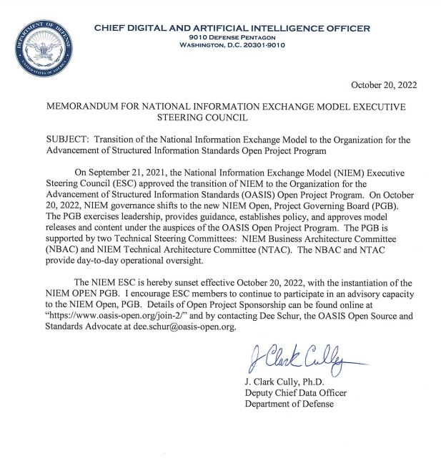
Transfer OF GOVERNANCE
20 October 2022 NIEMOpen ESC is Sunset and NIEMOpen Governance Transitions to the NIEMOpen OPEN Project Governing Board (PGB) under the Auspices of OASIS OPEN Project
ESC Principals remain in an Advisory Role
Dr. Cully Transition Memo

Slide 25

Transition to OASIS open project/governance
NIEMOpen Open
Project Governing Board
Executive Liaison Committee
Technical Steering Committee
(NIEMOpen NMO)
Technical Steering Committee
(NIEMOpen NBAC)
Technical Steering Committee
(NIEMOpen NTAC)
Domain X
(ex. MilOps)
NIEMOpen CORE
Domain Y
(ex. Cyber)
Governance
Committee
Communities of Interest

Slide 26














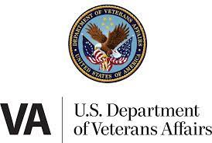





NIEMOpen SPONSORS
Sponsors
JS J6
DHS S&T
Equivant
GTRI
sFractal
NAJIS
IJIS
DOT
ODGA (Virginia)
S&T
S&T
In Discussions
Microsoft
DHS OBIM
MITRE
FBI
DHS OBIM
Expressed Interest
Government
of Canada
NIST
Veterans Administration
Tyler technologies
Ernst & Young
Ms. Carol Geyer
– OASIS Open Chief Development Officer

Slide 27







Contact Us
Katherine Escobar, katherine.b.escobar.civ@mail.mil, (757) 203-8631
Stephen Sullivan, stephen.m.sullivan14.ctr@mail.mil, (757) 203-8619
https://www.niem.gov/
https://niemopen.org/
https://www.linkedin.com/groups/1903175/profile
Git Repos
NIEMOpen: https://github.com/niemopen/
NTAC TSC
https://github.com/niemopen/ntac-admin
NBAC TSC
https://github.com/niemopen/nbac-admin
NMO TSC
https://github.com/niemopen/nmo-admin
NIEMOpen Slack Channel: https://niemopen.slack.com/
Mailing Lists
NIEMOpen: https://lists.oasis-open-projects.org/g/niemopen
PGB: https://lists.oasis-open-projects.org/g/niemopen-pgb
NTAC TSC: https://lists.oasis-open-projects.org/g/niemopen-ntactsc
NBAC TSC: https://lists.oasis-open-projects.org/g/niemopen-nbactsc
NMO TSC: https://lists.oasis-open-projects.org/g/niemopen-nmotsc
https://www.youtube.com/channel/UCg9qV22PXLBjG41hc-EwVrQ
Message Exchange Package (MEP Registry & Repository
Restricted Repository-WMAAFIP
NIEMOpen Message Exchange Package Builder

Slide 28
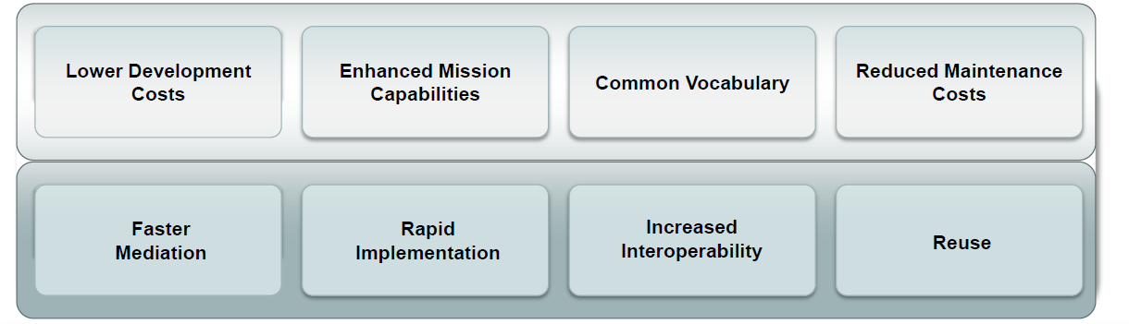
Why NIEM?
Collaboration
NIEMOpen brings stakeholders together through reuse and community engagement
Consistency
NIEMOpen provides consistency through reusable schema, which allows for many implementation options
Development
Flexible and extendable, NIEMOpen saves development time through agreed-upon elements, relationships, and formats independent of how information is stored in individual systems
Support
New users can leverage what already exists and engage directly with other NIEMOpen members for assistance.
WHICH LEADS TO
Notes:
So what does this all boil down to? Why NIEM? NIEMOpen provides:
Collaboration:
Consistency:
Development:
Support:
Resulting in enhanced mission capabilities and organizational cost avoidance from reduced development and maintenance costs.
Specifically,
Lower Development Cost:
Enhanced Mission Capabilities:
Common Vocabulary:
And Reduced Maintenance Costs:

Slide 29
Backup Slides

Slide 30
Managing a domain

Slide 31
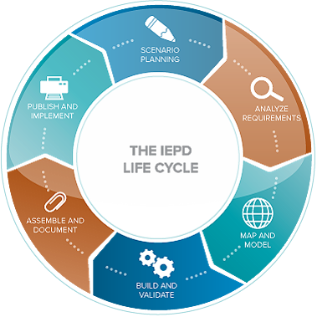
NIEM Domain Steward Work Areas
Establish Domain Governance Structure & Procedures
Domain Charter
Domain governance processes
Domain reference model configuration management processes
Domain Operation & Maintenance plan
Participate in monthly NBAC & NTAC meetings
Recruit external stakeholders (outside organizational community)
Develop Domain Reference Model Content
Develop data sharing use cases (scenario planning)
Identify data exchange requirements
Map and model data element needs
Build schemas and extension schemas
Submit Domain content to NMO

Slide 32
NIEM Domain Steward Work Areas
Piloting Opportunities
Assist early implementers with piloting activity
Provide content and content change recommendations
Share lessons learned across the Domain community
Refine Domain Operation & Maintenance procedures
Define domain relationship to community standards and architecture stakeholders
Promote outside community participation

Slide 33

Data Security
Security and privacy should always be key considerations when implementing an exchange.
Since 2012 ODNI and NIEMOpen worked together to enable the use of metadata to describe specific requirements in regards to information security and the handling of sensitive privacy-protected information. Including this metadata allows systems that implement NIEMOpen to automatically enforce rules that govern the use, protection, dissemination, and access controls for data being shared.
NIEMOpen includes the following security labeling standards for specifying security metadata in NIEMOpen exchanges:
Intelligence Community Information Security Marking (IC-ISM);
Intelligence Community Need-to-Know (NTK);
Intelligence Community Trusted Data Format (IC-TDF); and
Confidentiality Labeling and Binding for Joint Coalition Information Sharing
Including this metadata allows systems that implement NIEMOpen to automatically enforce rules that govern the use, protection, dissemination, and access controls for data being shared.
Encryption of information exchanges is not within the scope of NIEM. NIEMOpen can be used to structure the XML before encryption
NIEMOpen does not dictate how agencies handle privacy issues. Consult with your organization’s privacy standards.
Notes:
Broadly speaking, the technologies and methods needed to make data speak to each other already exist.
According to Data Management International (DAMA), the most serious impediments to interoperability often relate to how data is managed and how the lifecycle of data within and across organizations is governed. Data management, “the development, execution, and supervision of plans, policies, programs, and practices that deliver, control, protect, and enhance the value of data and information assets throughout their lifecycles” (DAMA 2017, 17), is therefore the cornerstone of any effort to make data more interoperable and reusable on a systemic scale.
To be effective, data management requires that data be effectively governed, controlled with oversight and accountability, as it moves within and between organizations during its lifecycle.
Since 2012 ODNI and NIEMOpen worked together to enable the use of metadata to describe specific requirements in regards to information security and the handling of sensitive privacy-protected information. Including this metadata allows systems that implement NIEMOpen to automatically enforce rules that govern the use, protection, dissemination, and access controls for data being shared.

Slide 34
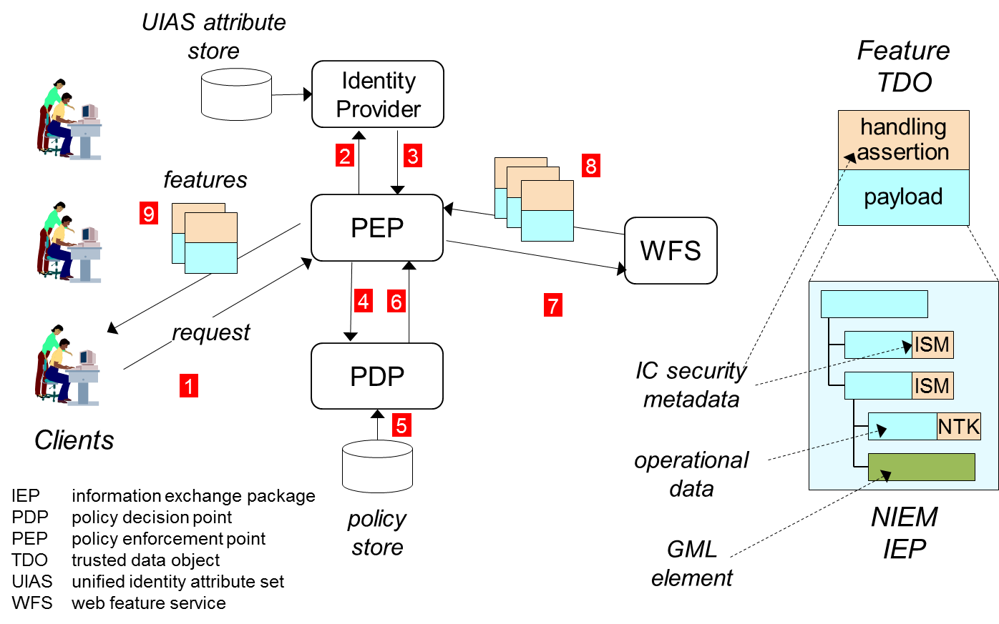
NIEMOpen Works With IC Security
Easy to include and enforce IC markings in a NIEMOpen information exchange package
34
Notes:
NIEMOpen defines many of the elements and attributes that would be required for tagging content in a privacy management system. For instance, the NIEMOpen includes metadata tags for association, source, and data quality, as well as a metadata type for extending the NIEMOpen to create additional content metadata tags.
The security labeling information to be included in NIEMOpen are specified in the IEPD. Specifically, the IEPD will detail the exact IC-ISM and IC-NTK elements that will be included in the NIEMOpen exchange. Furthermore, the payload and assertions are encapsulated in a transport container (IC-TDF) for exchange between autonomous domains and transport container protections are included in order to ensure the integrity and confidentiality of the information being exchanged.

Slide 35
Policy-based Access Control within NIEMOpen
The inclusion of security and privacy metadata allow systems that implement NIEMOpen to automatically enforce rules that govern the use, protection, dissemination, and access controls for data being shared. NIEMOpen does not provide these systems so other technologies are required to enforce security and privacy rules.
NIEMOpen Exchange
Notes:
NIEMOpen is technology agnostic in that it only addresses the format of data as it is shared between systems. NIEMOpen does not specify whether policy-based access control should be employed.
Framework does not define the rules for sharing, it provides the structure to articulate the rules
Framework is “implementation neutral”
Able to identify rules that were generic, reusable across multiple datasets
Would be able to build a library of reusable rules and rule templates

Slide 36
NIEMOpen Policy-Based Access Control in Use
Global Federated Identity and Privilege Management (GFIPM) is a program of the U.S. DOJ and the U.S. DHS that seeks to develop secure, scalable, and cost-effective technologies for information sharing within the criminal justice and intelligence communities.
GFIPM provides guidelines for federated authentication and for expressing user identity credentials in XML.
GFIPM technical standards and implementation guidance documents can be found at http://gfipm.net/

Slide 37
NIEMOpen Works In Low-Bandwidth Environment
Efficient XML Interchange (EXI) is the W3C standard for compressed binary XML data
For a properly designed schema, EXI produces messages very near the information-theoretic minimum size
Often smaller than hand-crafted binary message formats
Plenty of experimental evidence
Properly-designed schemas are always possible with NIEM
Nothing in NIEMOpen ensures a good low-bandwidth design
Nothing in NIEMOpen makes a good design impossible
In practice, good design with NIEMOpen is not difficult
People will always have bandwidth problems,
but these problems will not be caused by using NIEM

Slide 38
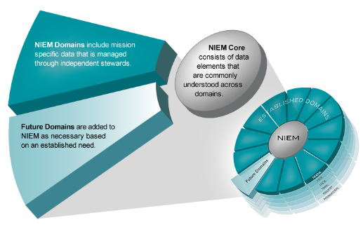
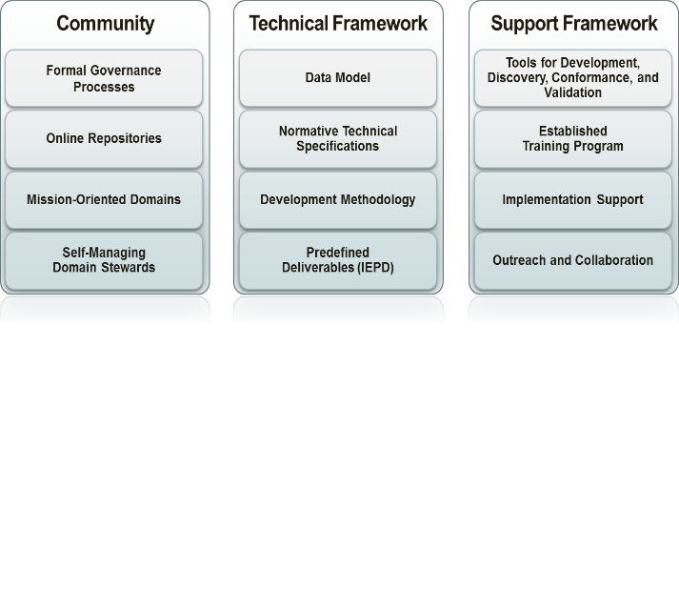
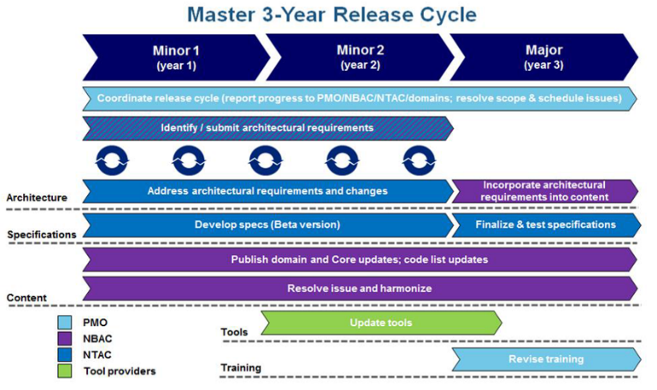
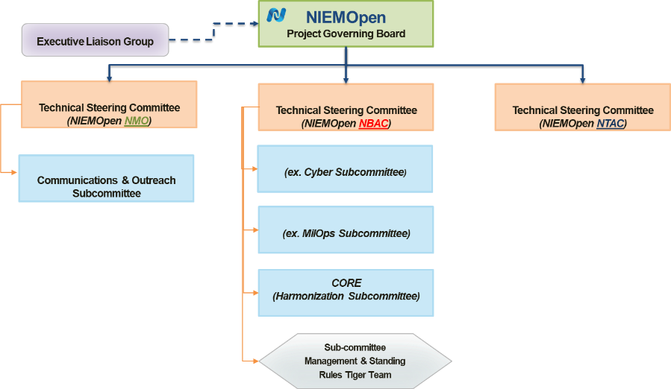
NIEMOpen INTRO – Wrapping it all up
Mature Community, Technical, & Support
Library of Reusable Data Components
Annual Release Cycle
Open Source Standard Governance

Slide 39
NIEMOpen Community Resources
These resources provide additional guidance on managing a domain:
GOVERNANCE
Guidance on Establishing Domain Governance – Detailed guidance for the domain governance model. Domains are advised to read this document before drafting a domain charter, and domain operations and maintenance (O&M) plans
Domain Charter Template – Standard format and guidance for the charter
Domain O&M Plan Template – Standard format and guidance the domain O&M plan
STAKEHOLDER ENGAGEMENT
Domain Community of Interest Guidance – Planned for development by the NMO
Domain Stakeholder Communications Guidebook – Planned for development by the NMO
DATA MODEL
NIEMOpen Naming and Design Rules (NDR) – Detailed design rules for domain data model structure
Model Package Description (MPD) Specification – Defines terminology, identifies required/optional artifacts and metadata, specifies normative rules, schemes and syntax, and provides non-normative guidance
Notes:
The NIEMOpen community provides a multi-tude of resources to assist you in your successful interoperability implementations:
Resources include a robust governance structure, access to the NIEMOpen Management office for support and guidance and ultimately the NIEMOpen data model, specifications and documentations.

Slide 40
RoadMap to Adoption
Scenario Planning
Map & Model
Assemble & Document
Plan the project, establish process, and identify information exchange business requirements
Business processes
Use Cases
Sequence Diagrams
Associate local objects with types and elements in NIEMOpen via mapping
Exchange content model
Mapping document
Prepare and package all related files for this Message Exchange into a single archive file
Main document
IEPD catalog
IEPD metadata
Sample XML instances
XML stylesheets
Analyze Requirements
Build & Validate
Publish & Implement
Further elaborate to understand and document the business context and data requirements
Business rules
Business requirements
Create a set of exchange-specific NIEMOpen conformant XML schemas that implement the data model created for the exchange
Subset schema
Exchange schema
XML want-list
Constraint schema
Extension schema
Publish to a repository for reuse and implement the exchange
Notes:
6 Steps
CSN will be assisting with in the test locations so we can verify the Message Exchanges work. Those packages will then be published for all SLTTs to use
No more and no less work than you’re probably already doing or will soon have to do

Slide 41
Message Exchanges Simplified
Who: Web and Application developers
Prerequisite: knowledge and experience in programming and application development
How: Programming in data exchange standards such as XML, JSON…
Develop a message exchange package (MEP) to be implemented in accordance with your software architecture and design
Common implementations include:
APIs – application programming interface. APIs are a common way to request and interface with data.
Message Queue – store NIEM-conformant XML, JSON, etc. instances within a message queue during its response to a stakeholder’s information request service
Web Services – embed a NIEMOpen conformant schema into a new or existing Web Service and perform an electronic transfer with one or more exchange partners
Once the data is received then you decide what to do with the data – e.g. ETL
Notes:
In the Get Request you will get back data in a common format such as XML or JSON.
When data is sent in the response, it’s sent as a string, or text.
In order to work with the data , you want to convert it into the type of object your system is using. This process of converting the string to an object is referred to as parsing.
A message exchange is like an API. It provides the documentation that tells the developers how to get/send the data and in what format. Extract, transform, load
The Data Package standard is a containerization format used to describe and package any collection of data, based on existing practices for publishing open-source software. It provides a "contract for data interoperability" through the specification of a simple wrapper and basic structure for data sharing, integration and automation without requiring major changes to the underlying data being packaged.
Its specification is based on the principles of simplicity and extensibility, and the ability to provide both human- editable and machine-useable metadata. It emphasizes the re-use of existing standard formats for data, and is language, technology and infrastructure-agnostic. To create a data package, one has only to create a 'datapackage.json' descriptor file in the top-level directory of a set of data files. This descriptor file contains general metadata (e.g., name of the package, licence, publisher, etc.) as well as a list of all the other files included in the package, along with information about them (e.g., size and schema).

Slide 42
Skill level to Implement NIEM
Developers with the skills to design and implement a data exchange can learn the NIEMOpen approach in a matter of hours
Developer training is available
No-cost online courses are on the NIEMOpen website
Plenty of example MEPs to follow
Don’t start from scratch, leverage shared MEPs
The NIEMOpen technical specifications are complex, however
Most developers do not need to read them
Free tools can perform most of the conformance checking
Notes:
Key – you aren’t starting from scratch.
You have CSN support, the NIEMOpen Management Office

Slide 43
Considerations for Adoption
Systems on either side of the exchange can use different implementation architectures (i.e., different programming languages, operating systems)
ARCHITECTURE
All participants in an information exchange must agree on the definition and structure for the data in the exchange—NIEMOpen provides this standardization
CONSISTENCY
IEPD Lifecycle should be used to guide development of NIEMOpen conformant information exchanges to make sure all the necessary artifacts are created
DEVELOPMENT
Elements already defined within NIEMOpen should be used whenever possible; exchange elements outside of or created to fill requirements not covered in NIEMOpen should also be reused whenever possible
REUSE
Notes:
If you’re thinking about adopting the first Message Exchange Packages – here’s what you should be considering

Slide 44
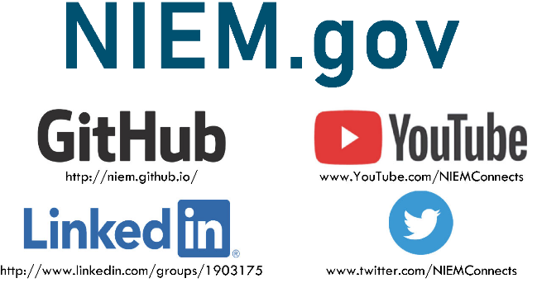
Contact Us
NMO Katherine Escobar (Katherine.b.escobar.civ@mail.mil), 757-203-8631
NMO Steve Sullivan (stephen.m.sullivan14.ctr@mail.mil), 757-203-8619
NBAC Kamran Atri (katri@a4safe.com), 703-930-6057
NBAC Thomas Krul (Thomas.krul@Canada.ca), 613-949-6513

Slide 45

WHERE DOES IT FIT? HOW DOES IT WORK? WHAT SHOULD I KNOW?
NBAC Face-to-Face
Cross- Domain
Interoperability
Stakeholders
(State, Local, DoD
Tribal, Federal…)
S&T
Smart
City
NBAC / NTAC Alignment
NIST/ISO
OASIS
Cyber
AI/ML
Open
Data
Open
Standards
Cross –
Domain
Academia
IoT
Security
Data
Notes:
Stakeholders, Benefits,
- Face-to-Face Discussion
NBAC/NTAC Alignment
External Standards Bodies

Slide 46
Ways to Use NIEM
Write producer or consumer software for a data exchange specified by others who used NIEM
ANSI/NIST-ITL 1-2011 (Biometrics)
N.25 Protocol (Radiological and nuclear detection)
Developers may not even know about NIEM
Reuse NIEMOpen data definitions without the exchange framework
Treating NIEMOpen like Dublin Core or schema.org
Design a NIEM-based exchange specification for known partner
Form a community that creates its own NIEMOpen model extension and/or set of exchange specifications
Participate in an existing NIEMOpen domain (or join the NTAC)
Stand up a new NIEMOpen domain and serve as domain steward
Notes:
At the simplest level, data scientists and software developers use a specification constructed through the NIEMOpen process as documentation for a data resource they need to produce or consume. In this case the users need not be aware of NIEMOpen at all. For example, the Automated Secure Alarm Protocol (ASAP) (https://apcointl.org/resources/interoperability/asap.html) is an ANSI standard that is used for machine-to-machine communication data between alarm monitoring companies and 911 centers. Its data format is NIEM-conforming and was created through the NIEMOpen process, but software developers building applications for the protocol do not have to know or care about that. They only have to produce or consume data that conforms to the specification.
The next level of NIEMOpen use is to reuse NIEMOpen components for one portion of a data resource. This treats the NIEMOpen model as just another data vocabulary among others, such as Dublin Core and schema.org.
Scientists and developers may create their own NIEM-based specification to document a data resource they produce. In this case all of the data components will be NIEM-conforming, whether reused from the NIEMOpen model, adapted from another standard, or created from scratch. Several scientist/developer teams may form a community to create a data resource specification as the standard for data they all produce and consume. Or they may agree on a set of data components they will all use, while not attempting to standardize each complete resource. This is very similar to a NIEMOpen domain’s activity. The new community may seek recognition as a new domain, or affiliation with an existing domain, but is not required to do so.
Scientists and developers can participate in a NIEMOpen domain’s activities, proposing new and modified data elements in the domain submodel for use in multiple specifications. A representative from a NIEMOpen domain will act as a voting member of the NIEMOpen Business Architecture Committee (NBAC). The NBAC governs the NIEMOpen core model; work here often involves harmonizing data definitions among the domain models to create elements that can be used in any domain. An individual may also be invited to participate in the NBAC as a non-voting observer.

Slide 47
Data Standards
The word “standard” is used to refer to a commonly agreed upon reference (a definition or specification) to allow for consistent measurement, qualification, or exchange of an object, a process, or a unit of information
Data standards are documented agreements on representations, formats, and definitions of common data...
Ensures that the precise meaning of exchanged information is understood and preserved throughout exchanges between parties.
Reduction of errors
Management of costs.
Ref: https://resources.data.gov/standards/concepts/.
Notes:
Without semantic interoperability, Interoperability conflicts arise Semantic conflicts can occur at two different levels, at the data level and at the schema level. Conflicts on a data level occur due to data differences in different domains. Conflicts on schema level are semantic conflicts characterized by differences in logical structures Data-level conflicts • Different representation and interpretation of similar data Schema-level conflicts • Different logical structure or inconsistencies in metadata 13 More on semantic conflicts: Peristeras - JIS-2008-34-6-877 - A conceptual analysis of semantic conflicts in pan-European e-government services Schema isomorphism conflict i.e. Different attributes on ID cards in different states How do you interpret this data?

Slide 48
“The Data Exchange Designer Is King”
Nothing in NIEMOpen or any NIEMOpen domain can ever dictate the information content of any data exchange
NIEMOpen rules for extension and reuse guarantee that every exchange designer will always be able to specify the exact information needed by his exchange participants
If you want more control over your enterprise or community, you must layer that governance on top of NIEM
NIEMOpen will work with
The agreement you can achieve
The flexibility you need
The control you choose to impose (within scale limits on data model size)
Notes:
So this is my NIEMOpen slogan for the DoD: “The Data Exchange Designer Is King”
Maybe you don’t want the data exchange designer to be King. Maybe you want to be the king, and the exchange designer merely a Baron or Duke or something underneath you. That’s fine – but you will have to provide that governance yourself. NIEMOpen does not do it for you.

Slide 49
NIEMOpen Is About Cooperation, Not Control
NIEMOpen Core and NIEMOpen domains create data components by consensus among data exchange designers
Components are established when participants believe that a common definition will make their exchanges easier to create and implement
Each domain changes on its own schedule, under its own control
Changes in the core or in a domain do not force changes in other domains or in any data exchange
No one is ever required to use a component that does not satisfy the data exchange needs, so there is no leverage for controlling the participants

Slide 50
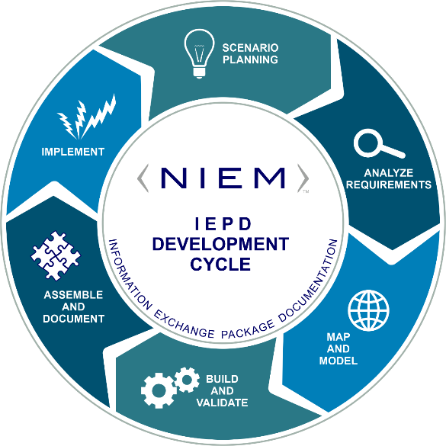
What is a NIEMOpen Information exchange?
In NIEM, an information exchange is also known as an Information Exchange Package (IEP), a description of specific information exchanged between a sender and a receiver.
The IEP is usually coupled with additional documentation, sample message instances, business rules, and more to compose an Information Exchange Package Documentation (IEPD)
Core Functions of an IEPD
Developed to provide the business, functional, and technical details of the information exchange through predefined artifacts
Created with a core set of artifacts in a prescribed format and organizational structure to allow for consistency
Designed to be shared and reused in the development of new information exchanges through the publication in IEPD repositories
Notes:
Let’s discuss what a NIEMOpen information exchange is and what its core functions are.
In NIEM, an information exchange is also known as an Information Exchange Package (IEP), a description of specific information exchanged between a sender and a receiver. The IEP is usually coupled with additional documentation, sample XML instances, business rules, and more to compose an Information Exchange Package Documentation (IEPD). An IEPD is the final product of the NIEMOpen information exchange development process, also known as the IEPD Lifecycle.
IEPDs have three core functions. IEPDs are:
Developed to provide the business, functional, and technical details of the information exchange through predefined artifacts.
Created with a core set of artifacts in a prescribed format and organizational structure to allow for consistency.
Designed to be shared and reused in the development of new information exchanges through the publication in IEPD repositories

Slide 51
model overview
Think of the NIEMOpen data model as a mature and stable data dictionary of agreed-upon terms, definitions, relationships and formats independent of how information is stored in individual agency systems
The data model consists of two sets of closely related vocabularies:
NIEMOpen core
Individual NIEMOpen domains
NIEMOpen core includes data elements commonly agreed upon across all NIEMOpen domains (i.e., person, activity, location, and item, etc.)
Individual NIEMOpen domains contain mission-specific data components that build upon NIEMOpen core concepts
Notes:
Now, let’s take a look at the NIEMOpen data model.
Words are to a dictionary as elements are to a data model. The NIEMOpen data model provides common, agreed-upon terms, definitions, and formats independent of how information is stored in individual systems.
It consists of two related vocabularies, NIEMOpen core and individual NIEMOpen domains.
NIEMOpen core consists of data elements that are commonly understood across domains. It’s governed jointly by all NIEMOpen domains.
A NIEMOpen domain represents both the governance and model content oriented around a community’s business needs. A NIEMOpen domain manages their portion of the NIEMOpen data model and works with other NIEMOpen domains to collaboratively identify areas of overlapping interest. As a community member of NIEM, your involvement could span one or more NIEMOpen domains. You also don’t need to be aligned to a formal NIEMOpen domain to use NIEM, as NIEM’s core elements are universal and applicable to many or all.
Future domains are added by NIEMOpen as necessary, based on an established business need.

Slide 52
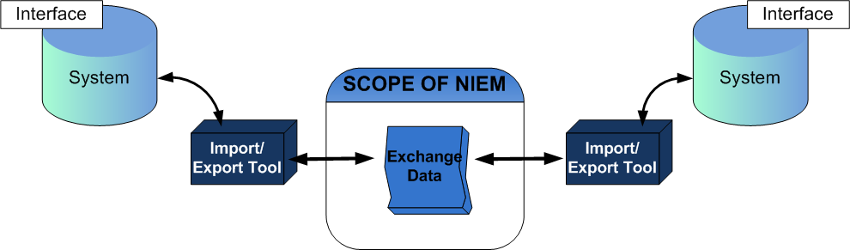
Scope of niem
NIEMOpen is a data layer standard and intentionally does not address all the necessary technologies needed for information sharing
Exchange partners decide how to store and process the NIEM-conformant data being exchanged
Notes:
NIEMOpen intentionally does not address standardizing data inside legacy systems. NIEMOpen serves as a translation layer (providing a common understanding) between and across disparate systems
In order to provide infrastructure flexibility, NIEMOpen does not define implementation specifications
NIEMOpen defines the format and structure of data in transit
Exchange partners decide how to store and process the NIEM-conformant data being exchanged
NIEMOpen can be established within an organization’s Service Oriented Architecture (SOA) as a data standard for all information exchanges
Security and privacy should be key considerations when implementing an exchange
Specific exchanges may contain metadata regarding security policies associated with the exchange (e.g., classifications such as SECRET or Secret But Unclassified—SBU), but it remains the responsibility of the applications, networks, and information systems that actually transact the exchanges to implement security services, transport, etc. IEPDs are themselves reusable, modifiable, and extendable.

Slide 53
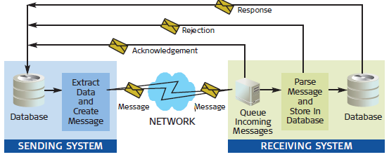
Scope of NIEM
NIEMOpen is a data layer standard and intentionally does not address all the necessary technologies needed for information sharing
Exchange partners decide how to store and process the NIEM-conformant data being exchanged
Notes:
NIEMOpen intentionally does not address standardizing data inside legacy systems. NIEMOpen serves as a translation layer (providing a common understanding) between and across disparate systems
Effective data sharing, across government agencies and other organizations, relies upon agreed meanings and representations.
There are three aspects of inter-application communication:
1. transport: refers to how the information gets across the wire
2. protocol: refers to how to package the information sent across
that wire
3. message: refers to the information itself
To send or receive a message, one must enable an application to do so — independent of the protocol used
Once one gets applications or organizations to agree on the meanings of the message, one can send a package of these messages to its intended destination. The meanings must be exact and unambiguous.
A data dictionary is suggested to list the data vocabularies, their meanings, and their associated schemas.

Slide 54
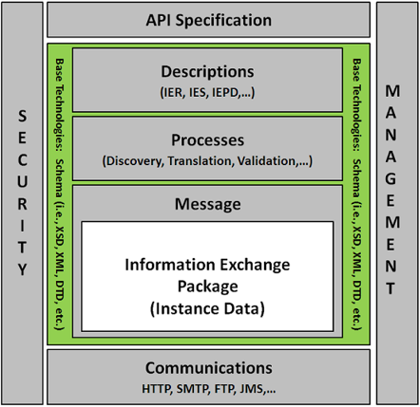
Scope of niem
NIEMOpen is a data layer standard and intentionally does not address all the necessary technologies needed for information sharing
Exchange partners decide how to store and process the NIEM-conformant data being exchanged
Notes:
NIEMOpen intentionally does not address standardizing data inside legacy systems. NIEMOpen serves as a translation layer (providing a common understanding) between and across disparate systems
In order to provide infrastructure flexibility, NIEMOpen does not define implementation specifications
NIEMOpen defines the format and structure of data in transit
Exchange partners decide how to store and process the NIEM-conformant data being exchanged
NIEMOpen can be established within an organization’s Service Oriented Architecture (SOA) as a data standard for all information exchanges
Security and privacy should be key considerations when implementing an exchange
Specific exchanges may contain metadata regarding security policies associated with the exchange (e.g., classifications such as SECRET or Secret But Unclassified—SBU), but it remains the responsibility of the applications, networks, and information systems that actually transact the exchanges to implement security services, transport, etc. IEPDs are themselves reusable, modifiable, and extendable.

Slide 55
NIEMOpen Community Stakeholders
The NIEMOpen community continuously communicates with six different stakeholder types
Each stakeholder is interested in NIEMOpen and how it can help their organization or project for different reasons
Executives
NIEMOpen minimizes the time-to-market while allowing maximum flexibility.
Program Managers
NIEMOpen can make a job easier by helping teams build exchanges in less time, for less money time.
Architects
NIEMOpen offers a better way to exchange data and is adaptable; it can be modified or new capabilities added to an existing exchange.
Developers
Tools and support are available to make exchange development easier and faster.
Implementers
NIEMOpen can lower the cost of maintenance in comparison to legacy formats.
Tool Providers
NIEMOpen can be an avenue to connect with customers who have an interest in information sharing capabilities.
Notes:
Now let’s talk about the NIEMOpen Community
NIEMOpen is built by the community, for the community.
The NIEMOpen community is comprised of:
Members from federal, state, local, tribal, territorial, private, and international organizations.
Within the context of NIEM, Communities of interest (COI) come together based on a common need to exchange information in order to advance their missions. COIs need to have a shared vocabulary for the information they exchange.
The NIEMOpen community’s shared commitment to interoperability drives the program forward.
NIEM’s active community contributes to model content, provides technical guidance, and offers tools and assets to streamline the development of exchanges.
Collaboration across different mission spaces and organizations is critical and provides areas that previously operated autonomously to work together successfully.
Successful information-sharing and exchange are best achieved through the active participation and collaboration of the many organizations involved in serving our nation and world.

Slide 56

Value Proposition – Interoperability
The interoperable nature of NIEMOpen establishes:
Common Language and Vocabulary
Agnostic Implementation
NIEMOpen eliminates confusion by providing consistency of data definitions between agencies
NIEMOpen is open-nonproprietary, scalable, tailorable. Platform, language, system, and network agnostic
NIEMOpen enables systems to work together at the data level
Implementers decide how agencies’ systems are implemented
Notes:
NIEMOpen enables systems to work together at the data level, Implementers decide how agencies’ systems are implemented
For SLTTs the value of interoperability is efficient sharing of IOCs and other compromise details among partner agencies in working groups and geographic regions, as well as an increased ability to connect related but currently silo’d systems from different agencies. Long term the use of NIEMOpen will also speed mandatory reporting due to compliance drivers and allow for more efficient tracking of large scale cyber incident details.

Slide 57

Value Proposition – Reusability
The reuse of IEPDs, in part and whole, within NIEMOpen will:
Decrease Development Time
Increase Consistency
Decreases the development time for information exchanges that use similar sets of data
Allows practitioners to increase the syntactic and semantic consistency in data definitions across their information exchanges

Slide 58

Value Proposition – Standardization
The formalization of NIEMOpen as a standard enables
Large Support Community
Structured Approach
NIEMOpen Practitioners can leverage NIEM’s large support community to decrease development time for exchanges and increase conformance
Repeatable approach that decreases the inconsistencies and duration of development

Slide 59
Interoperability Solution
The key factor to achieve Enterprise interoperability is data
To exchange data, systems must establish:
Semantic interoperability: is the ability of computer systems to exchange data with unambiguous, shared meaning. Semantic interoperability is a requirement to enable machine computable logic, inferencing, knowledge discovery, and data federation between information systems.
Syntactic interoperability: refers to the packaging and transmission mechanisms for data. Syntactic interoperability is a prerequisite for semantic interoperability. Enabled by metadata
Essential Metadata: data that defines and describes other data for Access, Correlation, Discovery, Records Management (Life cycle Management), Audit, and Protection
NIEMOpen is a tool for Interoperability Challenges at the Data Level
Notes:
What is interoperability? Interoperability, within the context of European public service delivery, is the ability of disparate and diverse organizations to interact towards mutually beneficial and agreed common goals, involving the sharing of information and knowledge between the organizations, through the business processes they support, by means of the exchange of data between their respective ICT systems. Source: EIF, http://ec.europa.eu/isa/documents/isa_annex_ii_eif_en.pdf
Interoperability is a characteristic of a product or system, whose interfaces are completely understood, to work with other products or systems, present or future, in either implementation or access, without any restrictions.
Ref: "Definition of Interoperability". dedicated website for a Definition of Interoperability at interoperability-definition.info. Copyright AFUL under CC BY-SA.
Ref: NCOIC, "SCOPE", Network Centric Operations Industry Consortium, 2008
Ref: ISO/IEC 11179-1 Information technology – Metadata registries (MDR) part 1: Framework

Slide 60
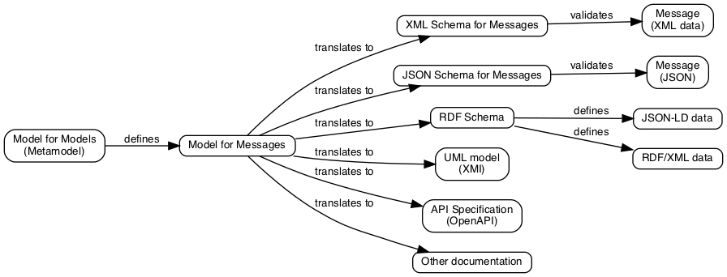
Transform a Model Into Required Representations
NIEM…More than XML
Notes:
Many of you may have considered NIEMOpen in the past but were hesitant to consider it’s use because of the tight coupling with XML. With many emerging technologies and data exchange formats, the NIEMOpen community recognized the need to decouple XML and make NIEMOpen useable with any technology. With the release of 5.0 in 2020, NIEMOpen deployed the first step in this transition to being a completely technology agnostic solution, and with subsequent releases of 5.1, 5.2 and ultimately 6.0, NIEMOpen will be accessible in any format be it XML, JSON, RDF, or Ontological representations for use in Data Centric solution.

Slide 61
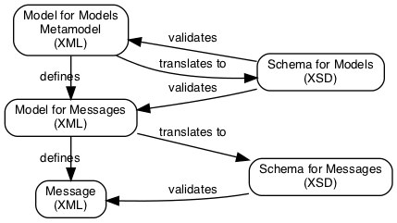
Step 1: NIEMOpen 5.0 Release
The NTAC has created a draft metamodel
Represents a NIEMOpen model (NIEMOpen data definitions) as a data object
Work in progress
We can represent NIEMOpen reference schemas as a "model description" data object
Most features are supported, but not necessarily all; it's a draft
This could be handled as XML, JSON, or other formats
We can convert NIEMOpen data descriptions into conformant XML Schema
The metamodel is represented as XML data

Slide 62
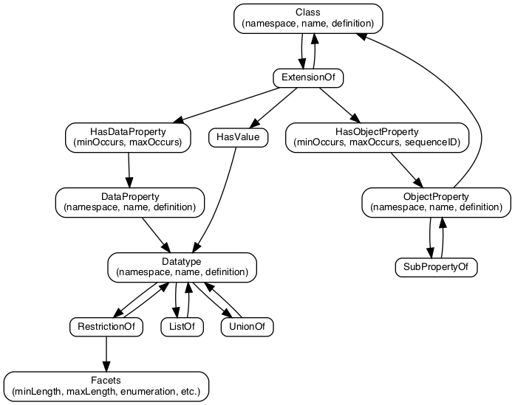
NIEMOpen Metamodel
The NIEMOpen metamodel is a data model that describes NIEMOpen data models
It carries the aspects of NIEMOpen models that we care about, without a focus on XML Schema-specific features
A data component has a name, namespace, and a human-readable definition:
A Class defines a category of object. e.g., a vehicle
A Datatype defines a category of simple data: e.g., a string, date, or enumeration
An Object Property represents a relationship to an object
A Data Property represents a characteristic with a simple data values
Notes:
A data model for NIEMOpen data models is a NIEMOpen metamodel
It defines a class of data objects that describe a NIEMOpen data models (a "model description" data object)
Represents the aspects of NIEMOpen model that we care about, without a focus on XML Schema-specific features
It describes what the NIEMOpen model is:
Namespaces: collect and label data components so that they can be governed and distinguished
Data components have names, namespaces, and human-readable definitions
Types: represent things and values
Classes that define categories of objects
Datatypes that define categories of text: strings, dates, enumerations
Properties: represent relationships and characteristics
Object properties: represent relationships to objects
Map to XML Schema elements
Data properties: represent relationships to simple data values
Map to XML Schema attributes

Slide 63
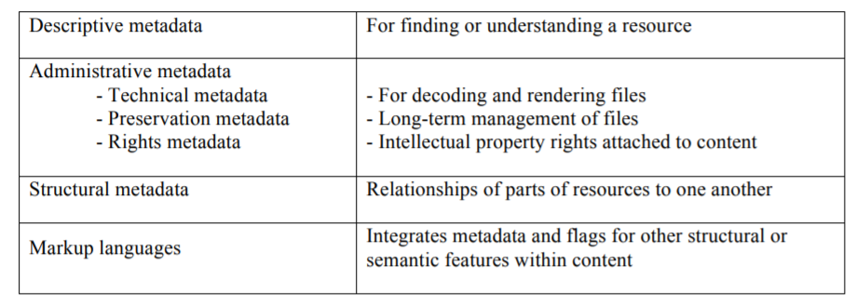
Metadata
Metadata is data that defines and describes other data
Types of metadata
Ref: https://groups.niso.org/apps/group_public/download.php/17446/Understanding%20Metadata.pdf
Notes:
What is interoperability? Interoperability, within the context of European public service delivery, is the ability of disparate and diverse organisations to interact towards mutually beneficial and agreed common goals, involving the sharing of information and knowledge between the organisations, through the business processes they support, by means of the exchange of data between their respective ICT systems. Source: EIF, http://ec.europa.eu/isa/documents/isa_annex_ii_eif_en.pdf

Slide 64
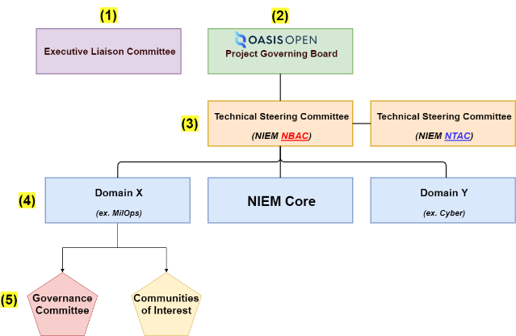
NIEMOpen Moves to OASIS
Becomes: an OASIS “Open Project”
Why the Move: it’s the next logical NIEMOpen maturity step and allows NIEMOpen to be designated a standard. This move shifts leadership and resourcing to the OASIS user community.
Aligns with the Law mandating the use of voluntary consensus standards over government developed standards:
National Technology Transfer and Advancement Act of 1995 (NTTAA), Public Law 104-113
Government at every level favors standards - OMB 119
Align with NIST the government cited assessment body for compliance of systems
Government and Industry favors formal standards
Inherent Interoperability due to rigor in vetting standards
Increases awareness of NIEMOpen to larger audience
NIEMOpen already meets most of the criteria for becoming a standard
Increased visibility, contribution, and use by open source tool developers
Compliance argument over competing government developed standards

Slide 65
Reasons for NIEMOpen an Open Source standard
Aligns with the Law mandating the use of voluntary consensus standards over government developed standards:
National Technology Transfer and Advancement Act of 1995 (NTTAA), Public Law 104-113
Government at every level favors standards - OMB 119
Align with NIST the government cited assessment body for compliance of systems
Government and Industry favors formal standards
Inherent Interoperability due to rigor in vetting standards
Increases awareness of NIEMOpen to larger audience
NIEMOpen already meets most of the criteria for becoming a standard
Increased visibility, contribution, and use by open-source tool developers
Compliance argument over competing government developed standards
Notes:
National Technology Transfer and Advancement Act of 1995 (NTTAA), Public Law 104-113 requires all federal government agencies to use, wherever feasible, standards developed or adopted by voluntary consensus standards bodies in lieu of developing government-unique standards or regulations
OMB 119 maintains a strong preference for using voluntary consensus standards over government to unique standards in Federal regulation and procurement
NIEMOpen included in other standards
ANSI 42.42 Radiological Nuclear detectors
ANSI APCO Alarm Monitoring Company to Public Safety Answering Point (PSAP)
OASIS EXDL FEMA
NIST Big Data Framework Vol 7
Nation Fire Protection NFPA 950 calls for compliance with NIEM. Emergency Incident Data Document (EIDD) IEPD – NISTIR 8255
Biometrics ANSI/NIST ITL Standard
Biometric Conformance Test Software (BioCTS)
BioCTS for AN-ITL v2 is a desktop application which tests electronic biometric data files, known as transactions, for conformance to NIST Special Publication (SP) 500-290
Conformance Test Architecture (CTA) and Test Suite (CTS) called "BioCTS for AN-2011 NIEMOpen XML" designed to test implementations of AN-2011 NIEMOpen XML encoded transactions.
NIEMOpen Cited in patent – Integrated Environment for Developing Information Exchanges patent No: US 8,769,480 B1 Dated July 1, 2014
Combination of Interoperability Registries with Process and Data Management tools for Governmental Services

Slide 66

NIEMOpen – The Big Picture
NIEMOpen enables organizations to move information across organizational boundaries in order to interoperate − and act as one − while each maintains authority for their own existing systems
Common Language (Data Model Lifecycle)
Repeatable, Reusable Process
(Exchange Specification Lifecycle)
Built and governed by users within the Federal, State, Local, Tribal, and Private Sectors
Notes:
There are two concepts that can be used to help illustrate NIEM.
The data model is the collective representation of the communities that leverage NIEM. This is where NIEMOpen provides a consistent set of data definitions and a structure to define the relationships between them. The diverse communities that leverage NIEMOpen collaboratively govern the data model.
The NIEMOpen Information Exchange Development Lifecycle, commonly referred to as the Information Exchange Package Documentation (IEPD) Lifecycle provides a repeatable, reusable process for using NIEMOpen to define information exchange.
Developers use the NIEMOpen process to define the syntax and semantics of some data resource. That resource can be the data passed through an API, or
messages sent from one system to another, a data document published on the web, etc. The process is:
1. Determine the information requirements. What are the facts to be conveyed in the data resource?
2. For each concept in the information requirements
2.1 Search for and select a data component in the NIEMOpen model to represent this concept. NIEMOpen provides tools to assist with this search: the Subset Schema Generation Tool (SSGT) and Movement.
2.2 Possibly adapt a data component from an external model, if there is no suitable component in the NIEMOpen model. For example, the NIEMOpen model provides several geospatial components adapted from Geographic Markup Language (GML).
2.3 Define a new data component for the missing concept, if there is no component suitable for reuse. Developers may share their new component for reuse by others, but are not obligated to do so.
3. Have new or modified information requirements been revealed? Change the requirements in step #1 accordingly and repeat.
4. When all of the information requirements are satisfied, assemble the selected data components into a schema that specifies the data resource.
This schema represents the resource’s content model (../../reference/models), which documents the meaning of each data component, defines which components are mandatory and optional, and may be used to validate individual instances of the resource during development or operations. The schema is the central component of a NIEM-based data resource specification, for historical reasons called the Information Exchange Package Documentation (IEPD). NIEMOpen supplies an IEPD framework for arranging documentation and gathering all of the artifacts needed by developers and analysts. Any number of consumers can use the specification to understand what to expect in the resource; any number of producers can use it to know what they are expected to provide

Slide 67
NIEMOpen in DoD
Military Standards
Messaging Text Formatting (US MTF) MilStd 6040
Tactical Data Link (TDL), Link 16, family of standards MilStd 6016
Intelligence
Navy NIEMOpen Maritime Domain
Maritime Information Sharing Environment (MISE)
Merchant Ship tracking (Coast Guard, Navy, Ports, UK Maritime)
Biometrics
Portable biometric readers used in Afghanistan / Iraq
Federal government biometric data sharing
Cyber
DHS-Led NIEMOpen Cyber Domain
Joint Non-Kinetic Effects (JNKE) for Offensive Cyber Operations information sharing
Sensors and Control (Best of NIEMOpen award winner 2018)
Infrastructure protection security sensors integration
Next Generation GPS Control System
NIEMOpen is a critical enabler for both the Mission Partner Environment (MPE)
and Combined Joint All Domain C2 (CJADC2)
https://www.niem.gov/about-niem/success-stories

Slide 68
NIEMOpen MILSTDs, CJCSIs, DODIs & STANAGs Candidates
Effort | Partner ORGs | Overview | Status
Integrating NIEMOpen via STANAGs NCDF STANAG 5653 | JS J6, Germany, NATO ACT / NCIA) | Semantics: MIP Information Model (MIM) UML format to NIEM-conformant XML creation. Syntax: NATO XML Naming Design Rules to mimic NIEM | Share COMPSPOT IEPD with German MTF Rep Nico (already approved by ACC). Once Nico’s support contract is in place, continue to engage and share as appropriate USMTF work already done. This will ensure quicker alignment between U.S. and NATO.
MILSTD 6040 (USMTF) NIEMOpen Conformance approach, STANAG 7149/APP-11 | USMTF CCB | Onboard/Technical Support to transform existing USMTF XML into a NIEMOpen conformant construct. Potential to include 20,000 new data components into the MilOps Domain | USMTF migrating to NIEMOpen XML; anticipate completion FY23; NATO MTF to evaluate U.S. product once released.
MILSTD 6016 (Link-16) Tactical Data Link J-series messages XML standardization STANAG 5516 | Joint Multi-TDL CCB | Approved Draft Interface Change Proposal to develop Appendix to provide guidelines for generation of J-Series message data as NIEMOpen conformant XML | The appendix to 6016 will provide for the conversion of J-series binary messages to XML; and back to binary. One of the primary considerations of this effort is NIEMOpen conformance. Two challenges currently being worked: J-Series messages do not convert directly to NIEM. Identification of a binary to XML conversion that will support NIEMOpen conformance. NATO ahead of U.S. w/ DFDL; U.S. considering leveraging DFDL to produce NIEMOpen conformant XML of J-series messages
MILSTD 6520 | NATO, Greece | C3B Interim Measure regarding geographical Entities for C3 Standards Addendum 2 to AC/322-N(2017)0092
MILSTD 2525 Symbology STANAG 2019/APP-6 |  |  | Both U.S. and NATO standards aligned; NIEMOpen v3.0 and v4.0 support exchanging SIDC codes.

Slide 69
NIEMOpen MILSTDs, CJCSI & STANAGs Candidates
Effort | Partner ORGs | Overview | Status
CJCSM 3265.01A JOINT COMMAND AND CONTROL (C2) REQUIREMENTS MANAGEMENT PROCESS AND PROCEDURES | Joint Staff |  | Currently reference NIEMOpen section 5.3 Mission Partner Interoperability, Section 7 Data
CJCSI 6610.01F TACTICAL DATA LINK STANDARDIZATION AND INTEROPERABILITY | Joint Staff |  | Currently reference NIEM
DODI 8110.01 MISSION PARTNER ENVIRONMENT INFORMATION SHARING CAPABILITY IMPLEMENTATION FOR THE DOD | DoD CIO |  | Section 1.2. Policy f 1 Section 2.10 OSD AND DOD COMPONENT HEADS, EXCEPT FOR DOT&E Currently require compliance with NIEM
DODI 8320.07 Implementing the Sharing of Data, Information, and Information Technology (IT) Services in the Department of Defense | DoD CIO |  | NIEMOpen First Policy
DODD 8190.01 Defense Logistics Management Standards (DLMS) | USD A&S |  | Incorporate x12 in compliance with NIEM

